Slide 1
Relational Database Model and Constraints
Notes:
Codd proposed the relational data model in 1970. At that time most database systems were based on one of two older data models (the hierarchical model and the network model); the relational model revolutionized the database and largely supplanted these earlier models.
Today, the relational model is by far the dominant data model and is the foundation for the leading DBMS products, including IBM's DB2 family, Informix, Oracle, Sybase, Microsoft's
Access and SQLServer, FoxBase, and Paradox.
Relational database systems are ubiquitous in the marketplace and represent a multibillion dollar industry.
We introduces the relational model and covers the following issues:
How is data represented?
What kinds of integrity constraints can be expressed?
How can data be created and modified?
How can data be manipulated and queried?
How do we obtain a database design in the relational model?
How are logical and physical data independence achieved?

Slide 2
Flat Database
Issues ?
Difficult to search
Difficult to generate reports
Difficult to sort data based on particular field
Notes:
Originally, databases were flat. This means that the information was stored in one long text file, called a tab delimited file.
The text file makes it difficult to search for specific information or to create reports that include only certain fields from each record (you have to search sequentially through the entire file to gather related information)
A relational database allows you to easily find specific information. It also allows you to sort based on any field and generate reports that contain only certain fields from each record. Relational databases use tables to store information.
It uses the relationship of similar data to increase the speed and versatility of the database.

Slide 3
Relational Database
Relational databases use tables to store information.
Issue with this table ?
Primary Key: uniquely identifies each record in the table
LName | FName | City | Age | Salary
Smith | John | New York | 35 | $280
Doe | Jane | Boston | 28 | $325
Brown | Scott | New York | 41 | $265
Howard | Shemp | New York | 48 | $359
Taylor | Tom | London | 22 | $250

Slide 4
Relational Database
“Relational” part ->
how multiple tables relate to each other,
allowing a user to extract information from a combination of tables
LName | FName | City | Age | Salary
Smith | John | 3 | 35 | $280
Doe | Jane | 1 | 28 | $325
Brown | Scott | 3 | 41 | $265
Howard | Shemp | 4 | 48 | $359
Taylor | Tom | 2 | 22 | $250
City # | City Name
1 | Boston
2 | London
3 | New York
4 | Los Angeles
Notes:
The relational model is very simple and elegant; a database is a collection of one or more relations, where each relation is a table with rows and columns.
This simple tabular representation enables even novice users to understand the contents of a database, and it permits the use of simple, high-level languages to query the data.
The major advantages of the relational model over the older data models are its simple data representation and the ease with which even complex queries can be expressed.

Slide 5
Relational Database vs Spreadsheet
Relational database is a big spreadsheet
that several people can update simultaneously
Each table in the database is one spreadsheet
Difference:
RD is more restrictive than a spreadsheet
All the data in one column must be of the same type, e.g., integer, decimal, character string, or date.
Rows in an RD are not ordered
RD allow user to enforce constraints
Example: Mailing List
Notes:
For example, in our mailing list database, the table has two columns: name and email. Each entry in the database consists of one row in this table
The table will be called mailing_list and will have two columns, both variable length character strings. We've added a couple of integrity constraints on the email column.
The not null will prevent any program from inserting a row where name is specified but email is not. After all, the whole point of the system is to send people e-mail so there isn't much value in having a name with no e-mail address. The primary key tells the database that this column's value can be used to uniquely identify a row. That means the system will reject an attempt to insert a row with the same e-mail address as an existing row.
This sounds like a nice feature, but it can have some unexpected performance implications. For example, every time anyone tries to insert a row into this table, the RDBMS will have to look at all the other rows in the table to make sure that there isn't already one with the same e-mail address. For a really huge table, that could take minutes, but if you had also asked the RDBMS to create an index for mailing_list on email then the check becomes almost instantaneous. However, the integrity constraint still slows you down because every update to the mailing_list table will also require an update to the index and therefore you'll be doing twice as many writes to the hard disk.

Slide 6
Formal Definitions
Schema of a Relation: R (A₁, A₂, .....A_{n})
Example:
STUDENT(Name, Ssn, Phone, Address, Age, Gpa)
Each attribute has a domain or a set of valid values.
Example:
Ssn: set of valid 9 digit social security numbers.
Phone: the set of 10 digit phone numbers valid in the United States.
Notes:
The main construct for representing data in the relational model is a relation.
A relation consists of a relation schema and a relation instance.
Schema consist of name and set of attribute…R is defined over attributes A1, A2, .....An
This is logical definitions of domains.
A data type or format is also specified for each domain.
For example, the data type for the domain Phone can be declared as a character string of the form (ddd)ddddddd, where each d is a numeric digit and the first three digits form a valid telephone area code.

Slide 7
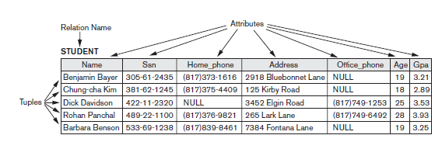
Formal Definitions
Relation State r(R) is set of n-tuples
Each n-tuple t is an ordered list of n values t =<v₁, v₂, ..., v_{n}>
where each value v_{i}, 1 ≤ i ≤ n, is an element of dom(A_{i}) or is NULL .
Notes:
A relation (or relation state)4 r of the relation schema R(A1, A2, ..., An), also
denoted by r(R), is a set of n-tuples r = {t1, t2, ..., tm}. Each n-tuple t is an ordered list
of n values t =<v1, v2, ..., vn>, where each value vi, 1 ≤ i ≤ n, is an element of dom
(Ai) or is a special NULL value.

Slide 8
Formal Definitions
A relation r(R) is a mathematical relation of degree n on the domains dom(A₁),..., dom(A_{n}).
r(R) is a subset of Cartesian product of the domains that define R
r(R) ⊆ (dom(A₁) × dom(A₂) × ... × dom(A_{n}))
Example:
Let S1 = {0,1} and S2 = {a,b,c}
r(R) ⊂ S1 X S2
r(R) = {<0,a> , <0,b> , <1,c> } is one possible “state”
Notes:
The degree (or arity) of a relation is the number of attributes n of its relation schema.
The earlier definition of a relation can be restated more formally using set theory concepts as follows. A relation (or relation state) r(R) is a mathematical relation of
degree n on the domains dom(A1), dom(A2), ..., dom(An), which is a subset of the Cartesian product (denoted by ×) of the domains that define R:
r(R) ⊆ (dom(A1) × dom(A2) × ... × dom(An))
The Cartesian product specifies all possible combinations of values from the underlying domains. Hence, if we denote the total number of values, or cardinality, in a
domain D by |D| (assuming that all domains are finite), the total number of tuples
in the Cartesian product is
|dom(A1)| × |dom(A2)| × ... × |dom(An)|
This product of cardinalities of all domains represents the total number of possible
instances or tuples that can ever exist in any relation state r(R). Of all these possible
combinations, a relation state at a given time—the current relation state—reflects
only the valid tuples that represent a particular state of the real world.
R: schema of the relation
r of R: a specific "value" or population of R.
R is called the intension of a relation
r is called the extension of a relation

Slide 9
Definitions using Set Theory
The total no of tuples in the Cartesian product is
|dom(A1)| × |dom(A2)| × ... × |dom(An)|
This shows the total no of possible tuples that can ever exist in any relation state r(R).
Notes:
Relation is formed over the Cartesian product of the sets
Each set has values from a domain
The Cartesian product specifies all possible combinations of values from the underlying
domains. Hence, if we denote the total number of values, or cardinality, in a
domain D by |D| (assuming that all domains are finite), the total number of tuples
in the Cartesian product is
|dom(A1)| × |dom(A2)| × ... × |dom(An)|
This product of cardinalities of all domains represents the total number of possible
instances or tuples that can ever exist in any relation state r(R). Of all these possible
combinations, a relation state at a given time—the current relation state—reflects
only the valid tuples that represent a particular state of the real world.
R: schema of the relation
r of R: a specific "value" or population of R.
R is called the intension of a relation
r is called the extension of a relation

Slide 10
Informal Terms |  | Formal Terms
Table |  | Relation
Column |  | Attribute/Domain
Row |  | Tuple
Values in a column |  | Domain
Table Definition |  | Schema of a Relation
Populated Table |  | Extension

Slide 11
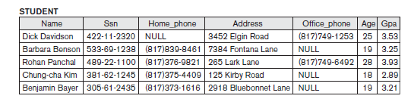
Characteristics Of Relations
Ordering of tuples in a relation r(R):
Notes:
A relation is defined as a set of tuples.
Mathematically, elements of a set have no order among them; hence, tuples in a relation do not have any particular order. In other words, a relation is not sensitive to the ordering of tuples
Tuple ordering is not part of a relation definition because a relation attempts to represent facts at a logical or abstract level.
When a relation is implemented as a file or displayed as a table, a particular ordering may be specified on the records of the file or the rows of the table.

Slide 12
Characteristics Of Relations
Ordering of attributes in a relation schema R
We define n-tuple as an ordered list of n values
Thus, attributes in R(A1, A2, ..., An) and the values in t=<v1, v2, ..., vn> are considered to be ordered .
Notes:
n-tuple is an ordered list of n values, so the ordering of values in a tuple—and hence of attributes in a relation schema—is important.
However, at a more abstract level, the order of attributes and their values is not that important as long as the correspondence between attributes and values is maintained.
An alternative definition of a relation can be given, making the ordering of values in a tuple unnecessary. In this definition, a relation schema R = {A1, A2, ..., An} is a set of attributes (instead of a list), and a relation state r(R) is a finite set of mappings r = {t1, t2, ..., tm}, where each tuple ti is a mapping from R to D, and D is the union (denoted by ∪) of the attribute domains; that is, D = dom(A1) ∪ dom(A2) ∪ ... ∪
dom(An).
n this definition, t[Ai] must be in dom(Ai) for 1 ≤ i ≤ n for each mapping
t in r. Each mapping ti is called a tuple.
According to this definition of tuple as a mapping, a tuple can be considered as a set
of (<attribute>, <value>) pairs, where each pair gives the value of the mapping
from an attribute Ai to a value vi from dom(Ai).

Slide 13
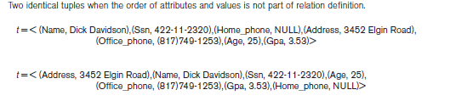
Characteristics Of Relations
An alternative definition of a relation can eliminate the need for ordering in tuple
Define tuple as a set of (<attribute>, <value>) pairs
Each pair gives the value of the mapping from an attribute Ai to a value vi from dom(Ai).
Notes:
When a relation is implemented as a file, the attributes are physically ordered as
fields within a record. We will generally use the first definition of relation, where
the attributes and the values within tuples are ordered, because it simplifies much of
the notation. However, the alternative definition given here is more general.5

Slide 14
Characteristics Of Relations
Values in a tuple:
Atomic (indivisible).
Null value
Domains of all attributes should be indivisible
Integers and strings,
Record structures: set, list, array … ?
Notes:
Each value in a tuple is an atomic value; that is, it is not divisible into components within the framework of the basic relational model. Hence, composite and multivalued attributes (see Chapter 7) are not allowed. This model is sometimes called the flat relational model.
An important concept is that of NULL values, which are used to represent the values of attributes that may be unknown or may not apply to a tuple. A special value,
called NULL, is used in these cases. For example, in Figure 3.1, some STUDENT tuples have NULL for their office phones because they do not have an office (that is, office
phone does not apply to these students).
In general, we can have several meanings for NULL values, such as value unknown, value exists but is not available, or attribute does not apply to this tuple (also known as value undefined).

Slide 15
RELATIONS
Relations represent facts about entities and relationships.
For example, consider a relation schema
MAJORS(Student_ssn, Department_code)
It asserts that students major in academic disciplines.
A tuple in this relation relates a student to his or her major discipline.

Slide 16
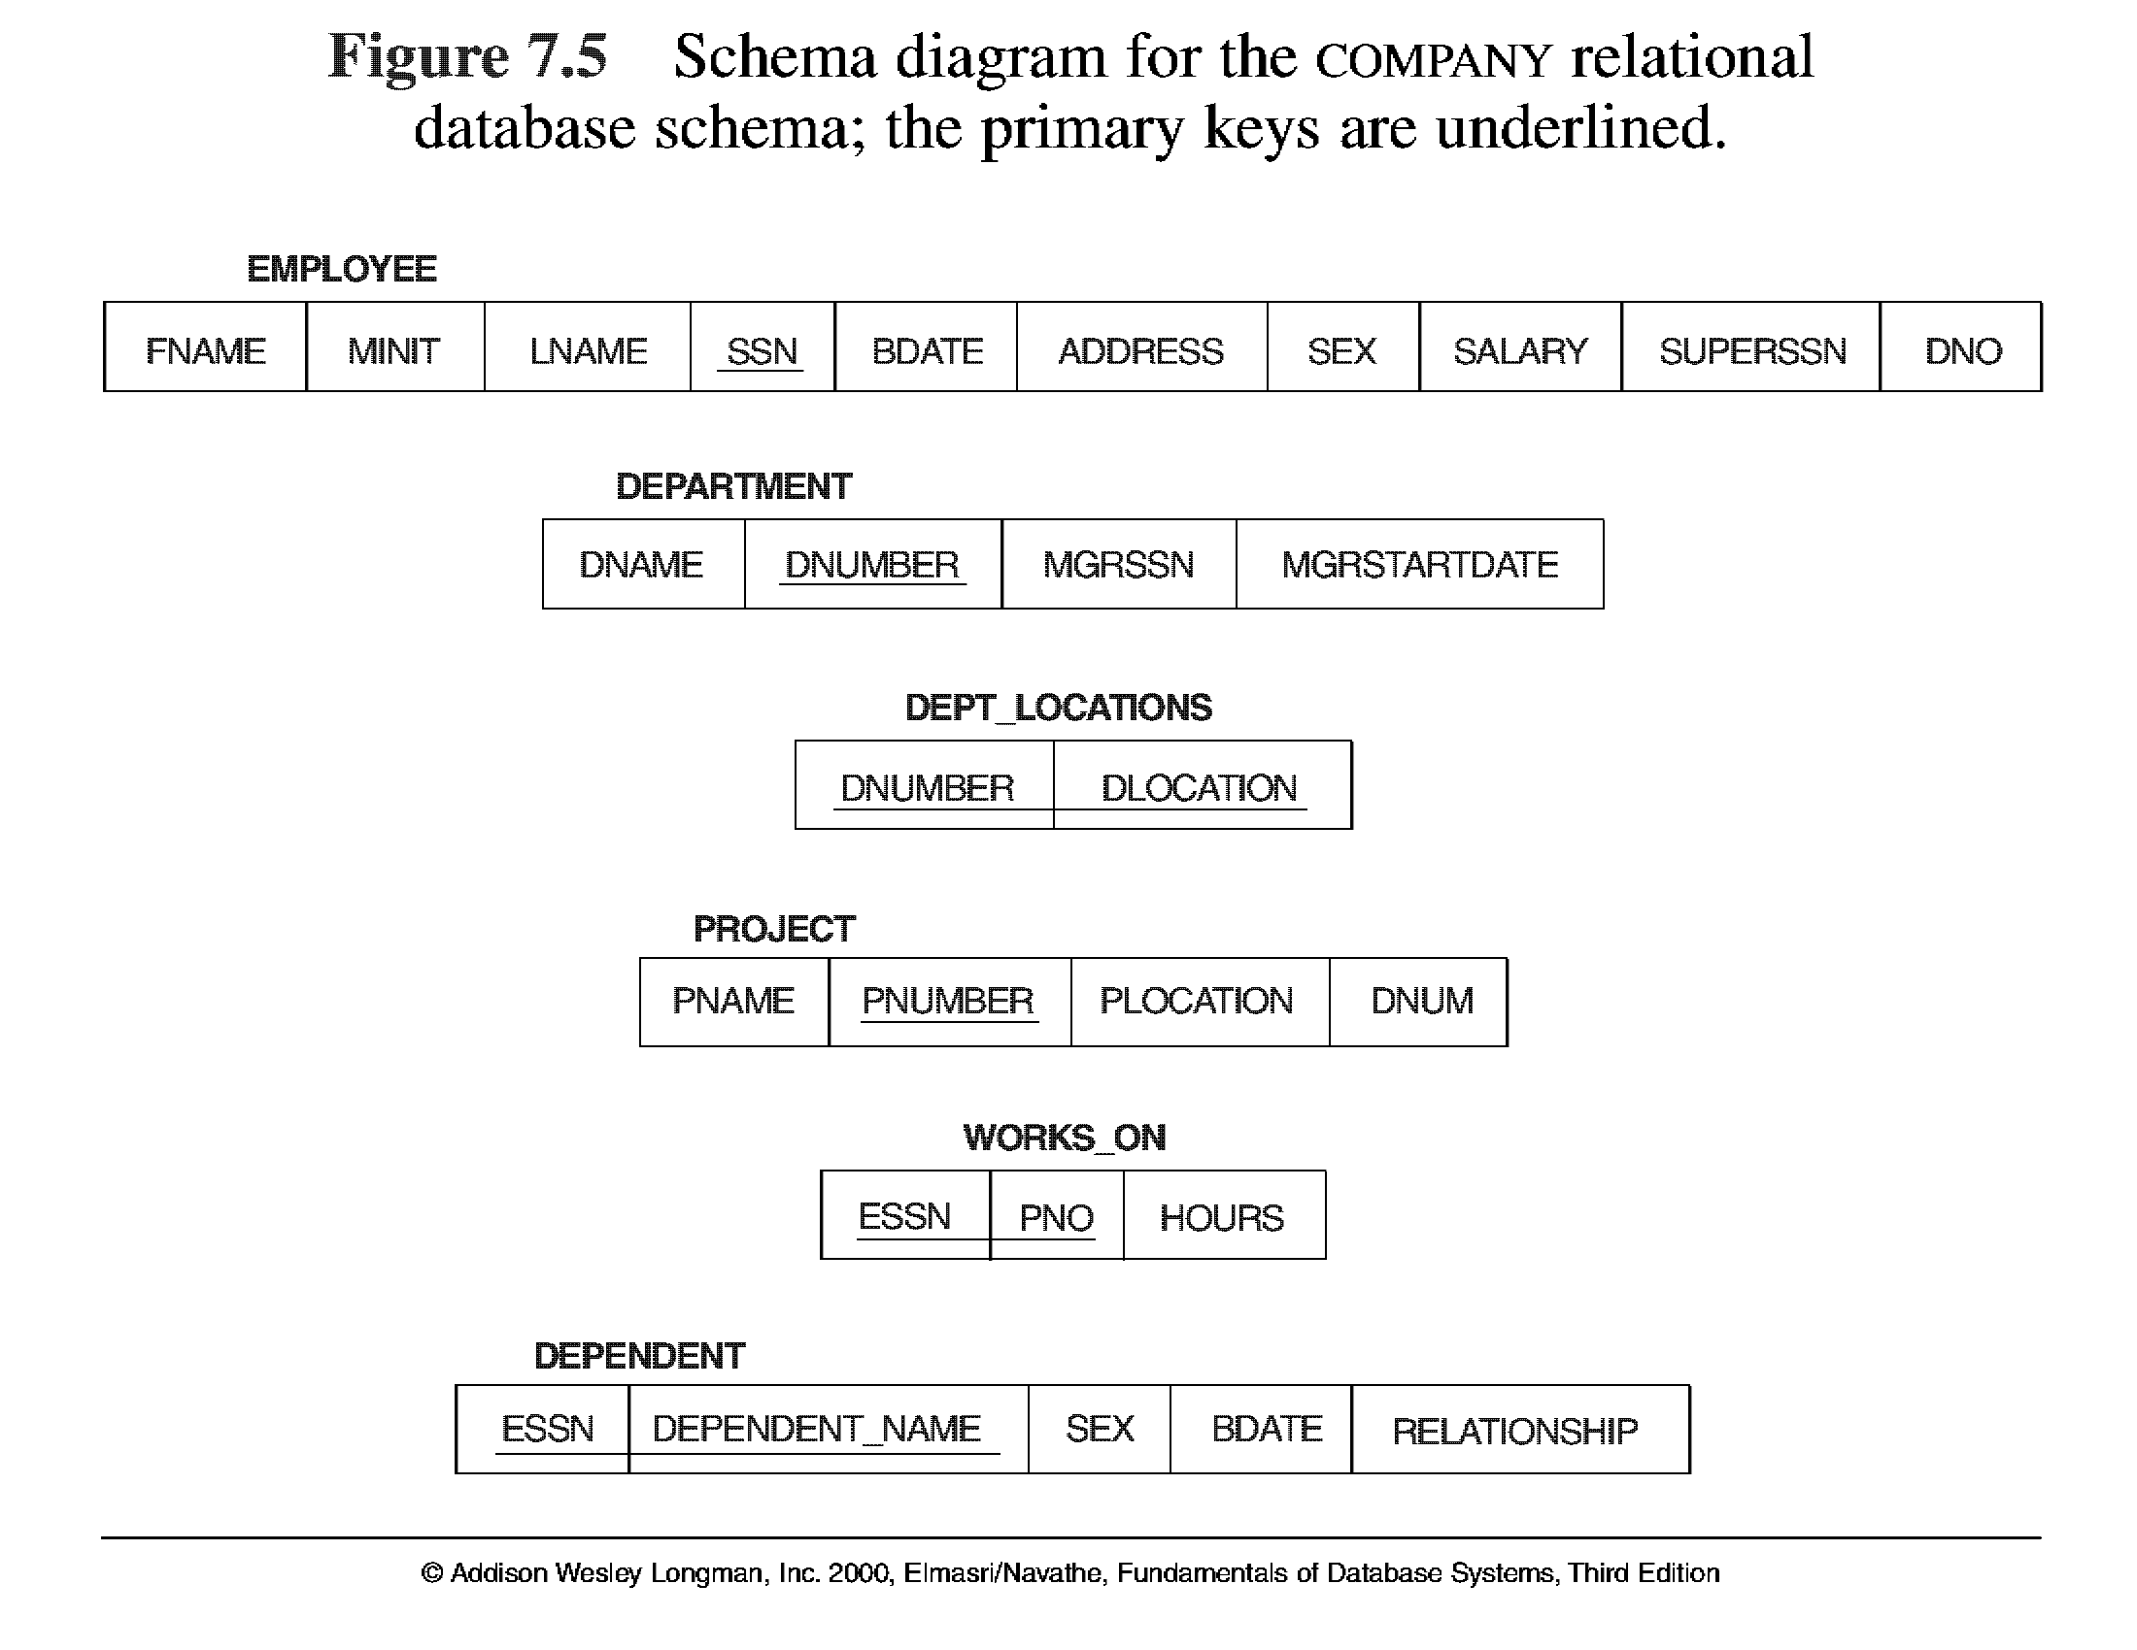
Why we need Multiple Tables
Why not put all attributes in one relation ?
Duplication
Primary key
Cannot insert value for employee with no assigned department … Null value in PK

Slide 17
Relational Database Constraints
Generally, there are many constraints on the values in a database state.
Constraints are derived from the rules in the mini-world
Notes:
In this section, we discuss the various restrictions on data that can be specified on a relational database in the form of constraints

Slide 18
Up-till now we have seen constraints
No duplicate tuples (rows)
Unique id (primary key )
Atomic value for domain of an attribute

Slide 19
Categories of Constraints
Model-based constraints or implicit constraints.
These are inherent in data model, like no duplicate rows in RDBMs table.
Schema-based or explicit constraints.
Can be expressed directly in the schema using DDL
Application based or semantic constraints or business rules.
Can’t be expressed directly in the schema
Must be enforced by the application programs

Slide 20
Schema-Based constraints
Domain constraints
Key constraints
Entity integrity constraints
Referential integrity constraints
Notes:
Domain constraints specify that within each tuple, the value of each attribute A must be an atomic value from the domain dom(A).
The data types associated with domains typically include standard numeric data types for integers (such as short integer, integer, and long integer) and real numbers (float and double precision float).
Characters, Booleans, fixed-length strings, and variable-length strings are also available, as are date, time, timestamp, and money, or other special data types.
Other possible domains may be described by a subrange of values from a data type or as an enumerated data type in which all possible values are explicitly listed.

Slide 21
Key Constraint
Relation is a set of tuples. Thus, all tuples must be distinct as all elements in the set are distinct
Example 1: Student Relation
Student(Name, SSN, Address, Phone, Major, Age, Gpa )
KEY is SSN, as it uniquely identify the student.
Example 2: Department Relation
Department(Dname, Dnumber, MgrSSN, Mgrstrdate)
KEY is Dnumber
Candidate Key Dname

Slide 22

Example of a university database

Slide 23
Key Constraint
Superkey:
For any distinct tuples t1 & t2 in r(R),
t1[SK] ≠ t2[SK].
Key:
A "minimal" superkey;
Key is a superkey from which we cannot remove any attribute and still have the uniqueness constraint hold.
Example:
Student(Name, SSN, Address, Phone, Major, Age, Gpa )
Consider set of attributes {Name, SSN, Age},
This set uniquely identify the student. This is SUPERKEY
KEY is SSN, minimal set that uniquely identify the student.
Notes:
A set of attributes SK of R such that no two tuples in any valid relation instance r(R) will have the same value for SK.
A super key is a set of fields that contains a key

Slide 24
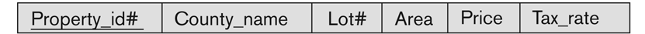
Key Constraint
Consider Property Schema
Key is Property_id#
Candidate Key (Country_name, Lot#)
This is a minimal superkey, as we cannot remove any attribute and still have a uniqueness constraint hold.

Slide 25
Key Constraint
Example 2: CAR relation schema
CAR(LicenseNo, Engine_SerialNo, Make, Model, Year)
Key
Key1 = {LicenseNo}
Key2 = {Engine_SerialNo},
These are also superkeys.
Superkey: {Engine_SerialNo, Make}
Candidate keys: If a relation has more then one key, we call it candidate keys
Notes:
If a relation has several candidate keys, one is chosen arbitrarily to be the primary key.
The primary key attributes are underlined.

Slide 26
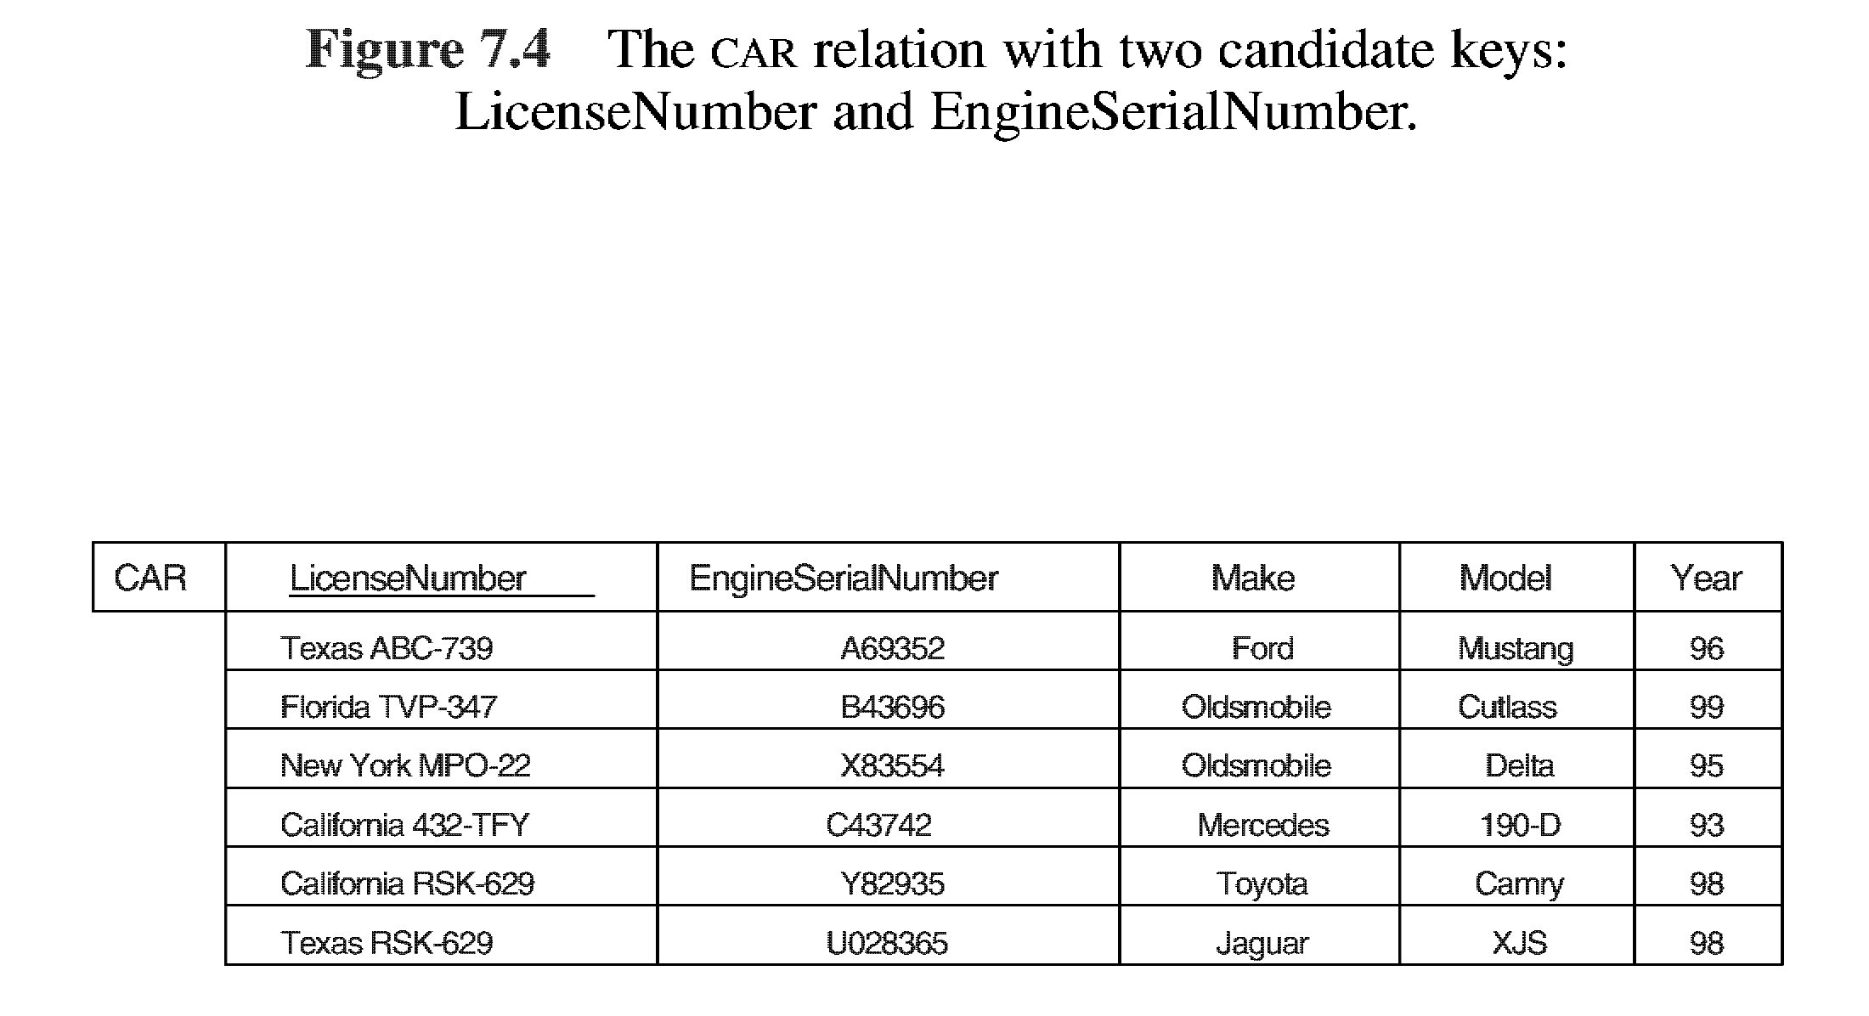

Slide 28
Integrity Constraints
Integrity constraints are specified on DB schema
They are expected to hold on every valid database state of the schema.
Integrity constraints ensure accuracy and consistency of data in a relational database.
Notes:
Schema S consist of many relations S = {R1, R2, ..., Rn} and State DB{r1,r2,…,rn) where each ri is the state of Ri.

Slide 29
Entity Integrity
Primary key is used to identify the individual tuples so it cannot have null value
Formally,
Schema S consist of many relations S = {R₁, R₂, ..., R_{n}} and State DB{r₁,r₂,…,r_{n}) where each r_{i} is the state of R_{i}.
Primary key attributes of each relation schema R in S cannot have null values in any tuple of r(R).
t[PK] ≠ null for any tuple t in r(R)

Slide 30
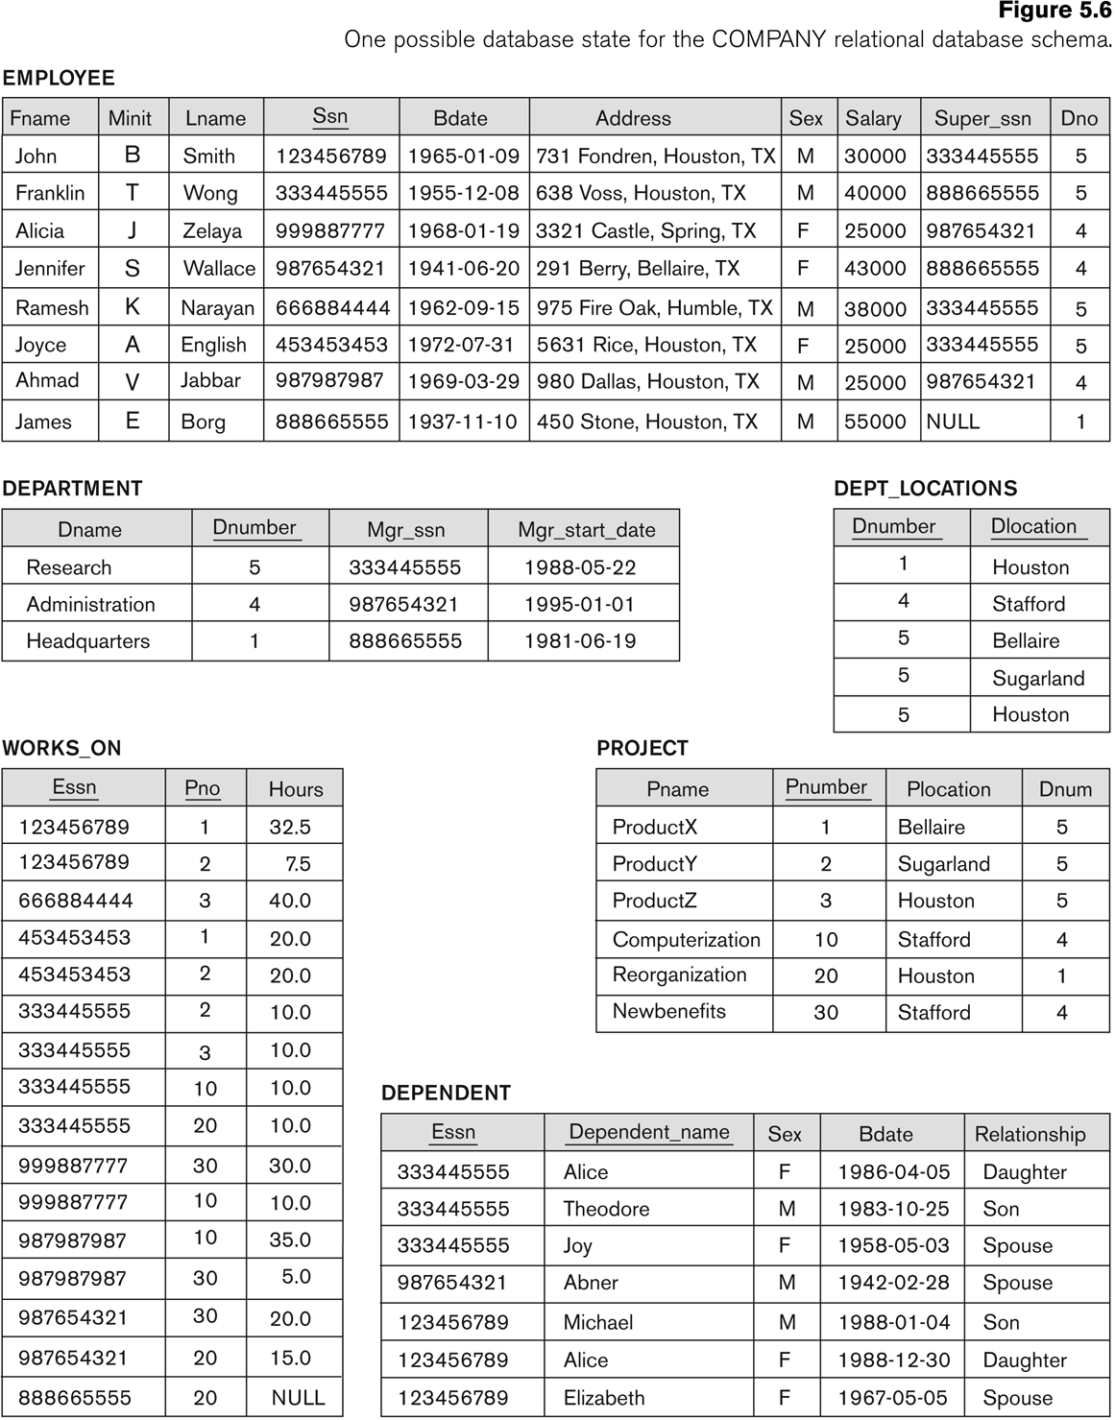
Notes:
Example:
Dno in employee record specify the department for which employee works.
Hence its value in each employee tuple must match the Dnumber value of some tuple in Department relation

Slide 31
Referential Integrity
A tuple in one relation that refers to another relation must refer to an existing tuple in that relation.
This is specified to maintain consistency among tuples in the two relations.
Notes:
Key constraints and entity integrity constraints are specified on individual relations.
The referential integrity constraint is specified between two relations and is used to maintain the consistency among tuples in the two relations. Informally, the referential
integrity constraint states that a tuple in one relation that refers to another relation must refer to an existing tuple in that relation.

Slide 32
Foreign Key (FK)
A foreign key is a field in a table that matches the primary key column of another table.
Set of attributes FK in relation R₁ is called foreign key of R₁ that reference R₂ if
Attributes in FK in R₁ has same domain as the attributes in PK of R₂
Value of FK must be an existing PK value in R₂ or null.

Slide 33
Foreign Key (FK)
Tuple t1 in R1 is said to reference a tuple t2 in R2 if t1[FK] = t2[PK].
R1 is referencing relation and R2 is reference relation

Slide 34
Specify Referential Integrity Constraints
Notes:
Example:
Dno in employee record specify the department for which employee works.
Hence its value in each employee tuple must match the Dnumber value of some tuple in Department relation

Slide 35
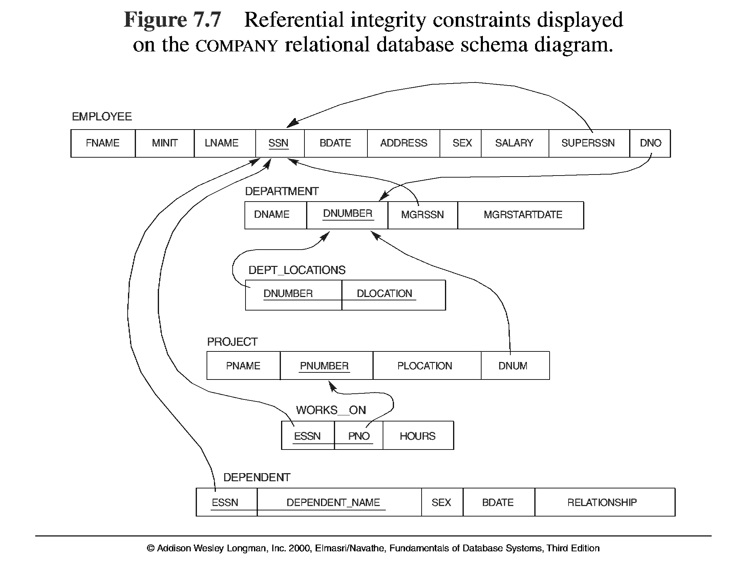
5.7
Notes:
NOTE: A foreign key can be a primary key or any of the candidate key in the referenced relation. The FK requires that uniqueness constraint should hold for the col on which it is defined in referenced relation.
Sql server allows specifying FK on a col which has uniqueness constraint set.

Slide 36
Foreign Key (FK)
A foreign key can be a primary key or any of the candidate key in the referenced relation.
FK requires that uniqueness constraint should hold for the column on which it is defined in referenced relation.
Sql server allows specifying FK on a column which has uniqueness constraint set.

Slide 37
Semantic Integrity Constraints
Based on application semantics and cannot be expressed by the model schema
Example
The max no of hours per employee for all projects he or she works on is 56 hrs per week
Employee salary should not exceed supervisor salary
SQL-99 allows triggers and ASSERTIONS to allow for some of these
Notes:
A constraint specification language may have to be used to express these.
It is more common to check for these types of constraints within the application programs than to use constraint specification languages because the latter are sometimes difficult and complex to use

Slide 38
Operations in RDBMS
Operations in RDBMS are classified as
Retrieval
Update
Update Operations on Relations
INSERT a tuple.
DELETE a tuple.
MODIFY a tuple.
Integrity constraints should not be violated by the update operations.

Slide 39
Insert Operation
Insert Operation can violate following constraints
Domain constraint
Key constraint (if key value already exists)
Entity (if PK contains NULL)
Referential (FK refers to a tuple that does not exist in referenced relation)

Slide 40
Insert Operation
Insert <‘Cecilia’, ‘F’, ‘Kolonsky’, NULL, ‘1960-04-05’, ‘6357 Windy Lane, Katy, TX’, F, 28000, NULL, 4> into EMPLOYEE.
Notes:
1. Result: This insertion violates the entity integrity constraint (NULL for the
primary key Ssn), so it is rejected.

Slide 41
Insert Operation
Insert <‘Cecilia’, ‘F’, ‘Kolonsky’, ‘677678989’, ‘1960-04-05’, ‘6357 Windswept, Katy, TX’, F, 28000, ‘987654321’, 7> into EMPLOYEE.
Notes:
3. Result: This insertion violates the referential integrity constraint specified on
Dno in EMPLOYEE because no corresponding referenced tuple exists in
DEPARTMENT with Dnumber = 7.

Slide 42
Insert Operation
Insert <‘Alicia’, ‘J’, ‘Zelaya’, ‘999887777’, ‘1960-04-05’, ‘6357 Windy Lane, Katy,TX’, F, 28000, ‘987654321’, 4> into EMPLOYEE.
Notes:
Result: This insertion violates the key constraint because another tuple with
the same Ssn value already exists in the EMPLOYEE relation, and so it is
rejected.

Slide 43
Delete Operation and Constraints
Delete operation can violate
Referential Integrity constraint
Delete the EMPLOYEE tuple with Ssn = ‘999887777’.
Delete the EMPLOYEE tuple with Ssn = ‘333445555’.
Notes:
Result: This deletion is not acceptable, because there are tuples in WORKS_ON that refer to this tuple. Hence, if the tuple in EMPLOYEE is deleted, referential integrity violations will result
Result: This deletion will result in even worse referential integrity violations, because the tuple involved is referenced by tuples from the EMPLOYEE,
DEPARTMENT,WORKS_ON, and DEPENDENT relations.

Slide 44
Notes:
Example:
Dno in employee record specify the department for which employee works.
Hence its value in each employee tuple must match the Dnumber value of some tuple in Department relation

Slide 45
Update Operation and Constraints
Update operation
that involve no PK or FK cause no problem ... only domain constraint are to be check
Modifying PK is like deleting a tuple and then inserting another

Slide 46
Update Operation and Constraints
Update the Dno of the EMPLOYEE tuple with Ssn = ‘999887777’ to 7.
Update the Ssn of the EMPLOYEE tuple with Ssn = ‘999887777’ to ‘987654321’.
Notes:
Result: Unacceptable, because it violates referential integrity.
Result: Unacceptable, because it violates primary key constraint by repeating
a value that already exists as a primary key in another tuple; it violates referential
integrity constraints because there are other relations that refer to the
existing value of Ssn.

Slide 47
Notes:
Example:
Dno in employee record specify the department for which employee works.
Hence its value in each employee tuple must match the Dnumber value of some tuple in Department relation

Slide 48
Operations and Constraints
Insert Operation can violate following constraints
Domain constraint
Key constraint (if key value already exists)
Entity (if PK contains NULL)
Referential (FK refers to a tuple that does not exist in referenced relation)
Delete operation can violate
Referential Integrity constraint
Update operation
that involve no PK or FK cause no problem ... only domain constraint are to be check
Modifying PK is like deleting a tuple and then inserting another

Slide 49
In case of integrity violation, several actions can be taken:
Cancel the operation that causes the violation (REJECT option)
Perform the operation but inform the user of the violation
Trigger additional updates so the violation is corrected (CASCADE option, SET NULL option)
Execute a user-specified error-correction routine

Slide 50
In Class Exercise
Exercise: Consider the following relations for a database that keeps track of student enrollment in courses and the books adopted for each course:
STUDENT(SSN, Name, Major, Bdate)
COURSE(Course#, Cname, Dept)
ENROLL(SSN, Course#, Quarter, Grade)
BOOK_ADOPTION(Course#, Quarter, Book_ISBN)
TEXT(Book_ISBN, Book_Title, Publisher, Author)
Draw a relational schema diagram specifying the foreign keys for this schema.

Slide 51
Assignment #1
Due before start of the class

